Slide 1
CSCI1540 Fundamental Computing with C++
Characters and Strings
Fall, 2019

Slide 2
Characters
A character (a char-type value) is represented internally as an 8-bit integer that corresponds to the ASCII code of the character
ASCII: American Standard Code for Information Interchange
E.g., 'A' is 65, '1' is 49, 'a' is 97, ' ' is 32, …
See next page for the ASCII code of each character
Note: Non-English characters are represented using other data types. (Won't be discussed in this course)

Slide 3
ASCII Table
 | 0 | 1 | 2 | 3 | 4 | 5 | 6 | 7 | 8 | 9
0 | NUL | SOH | STX | ETX | EOT | ENQ | ACK | BEL | BS | HT
10 | NL | VT | NP | CR | SO | SI | DLE | DC1 | DC2 | DC3
20 | DC4 | NAK | SYN | ETB | CAN | EM | SUB | ESC | FS | GS
30 | RS | US | SP | ! | " | # | $ | % | & | '
40 | ( | ) | * | + | , | - | . | / | 0 | 1
50 | 2 | 3 | 4 | 5 | 6 | 7 | 8 | 9 | : | ;
60 | < | = | > | ? | @ | A | B | C | D | E
70 | F | G | H | I | J | K | L | M | N | O
80 | P | Q | R | S | T | U | V | W | X | Y
90 | Z | [ | \ | ] | ^ | _ | ` | a | b | c
100 | d | e | f | g | h | i | j | k | l | m
110 | n | o | p | q | r | s | t | u | v | w
120 | x | y | z | { | | | } | ~ | DEL

Slide 4
Some Special Characters
Symbol | ASCII | Description | Escaped character in C++
NUL | 0 | Null character | '\0'
BEL | 7 | Bell (cause a beep) | '\a'
BS | 8 | Backspace | '\b'
HT | 9 | Horizontal tab | '\t'
NL | 10 | Line feed | '\n'
VT | 11 | Vertical tab | '\v'
NP | 12 | Formfeed | '\f'
CR | 13 | Carriage return | '\r'
ESC | 27 | Escape
SP | 32 | Space | ' '
DEL | 127 | Delete

Slide 5
char-Type Values
A char-type value, when used in an arithmetic expression, is treated as an integer
In output, a char-type value appears as a character
Examples:
1
2
3
4
5
6
7
8
9
10
cout << 'A'; // Prints A
int x = 'A'; // 'A' is coerced to 65 first
char ch = 65; // ch is assigned symbol of ASCII 65
cout << x; // Prints 65 because x is of type int
cout << ch; // Prints A because ch is of type char
ch = ch + 1; // ch becomes symbol of ASCII 66
cout << ch; // Prints B

Slide 6
Manipulating Characters: Example
1
2
3
4
5
6
7
8
9
10
11
12
13
14
15
16
17
18
19
char ch;
…
/* If ch holds a lowercase letter, output the letter's
"position" in the English alphabets.
'a' is the 1st letter, 'z' is the 26th letter */
if (ch >= 'a' && ch <= 'z')
cout << ch - 'a' + 1;
/* If ch holds an uppercase letter, convert the letter to
the equivalent lowercase letter */
if (ch >= 'A' && ch <= 'Z')
ch = 'a' + (ch - 'A');
/* If ch holds a digit ('0' to '9'), calculate the integer
value represented by that digit */
if (ch >= '0' && ch <= '9') {
int digitValue = ch - '0';
…
}
ch >= 'a' and ch >= 97 are evaluated equally but the former is more meaningful

Slide 7
Character Manipulation Functions
(Optional)
Need to #include <cctype>
Functions | Returns a non-zero value if ch is one of these characters:
int isalpha(int ch); | 'A' – 'Z', 'a' – 'z'
int isdigit(int ch); | '0' – '9'
int islower(int ch); | 'a' – 'z'
int isupper(int ch); | 'A' – 'Z'
int isspace(int ch); | ' ', '\n', '\t', '\f', '\v', '\r'
Functions | Returns:
int tolower(int ch); | The equivalent lowercase letter if ch is uppercase; otherwise returns ch
int toupper(int ch); | The equivalent uppercase letter if ch is lowercase; otherwise returns ch
Reference: http://www.cplusplus.com/reference/clibrary/cctype/

Slide 8
Strings
A string is a sequence of characters
E.g.: "I love CSCI!"
String length = the total number of characters in the string
E.g., Length of "ABC DEF\n" is 8
\n is considered as one character only
Each character in a string has a position
The 1st character has position 0
The last character has position string_length - 1

Slide 9
String "…" vs Character '…'
A string is enclosed by a pair of double quote
"A" – A string containing only one character A
"ABC" – A string containing three characters
"" – An empty string (A string that contains no character)
A character is enclosed by a pair of single quote
'A' – A character A
'\n' – A newline character
'\0' – A null character
'' – Error! We don’t have “empty character”
The data type of a string in the form "…" is array of char (i.e., “char []”, or “char *”)

Slide 10
Representing Strings in C++
There are two representation of strings in C++
As null-terminated strings
A null-terminated string (also called c-string) is an array of char (i.e., “char []”, or “char *”)
The end of the string is indicated by a null character ('\0', ASCII value 0) in the array
As string objects

Slide 11
Null-terminated Strings (c-strings)
Inherited from the C Language
A null-terminated string is represented as an array of characters in which the first null character (i.e., the one with the smallest index) in the array indicates the end of the string
E.g.:
when treated as a string, represents “ABC”
Manually insert the null character
char s1[7] = { 'A', 'B', 'C', '\0', 'D', '\0', 'E' };
 | A | B | C | \0 | D | \0 | E
Index | 0 | 1 | 2 | 3 | 4 | 5 | 6

Slide 12
Initializing an Array of char as a C-String
(Optional)
Initialize the first 4 positions as 'A', 'B', 'C', and '\0'
s1 can store any strings with length ≤ 9
1
2
3
4
5
6
7
8
9
10
11
12
13
char s1[10] = "ABC";
// s2 has size 11. Last character is '\0'
char s2[] = "abcdefghij";
cout << s1 << endl; // Output ABC
cout << s2 << endl; // Output abcdefghij
s2[4] = '\0'; // Replace 'e' by '\0'
cout << s2 << endl; // Output abcd
// Note: s2[5...10] remains unchanged
cout << s2[6] << endl; // Output g
Null character is automatically added
Null character is automatically added
s2 | a | b | c | d | e | f | g | h | i | j | \0
\0

Slide 13
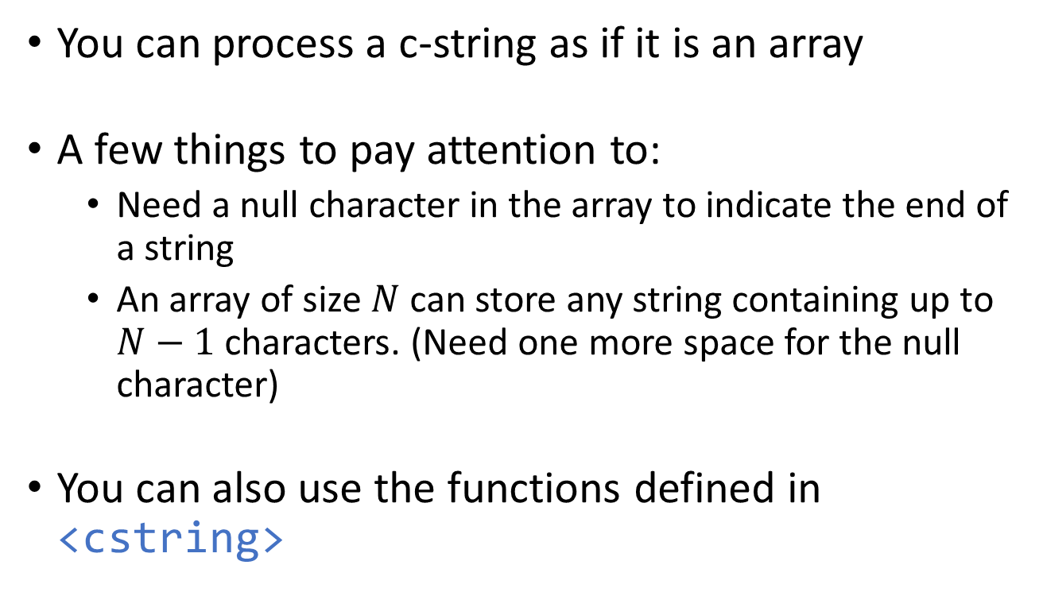
Processing C-Strings
(Optional)
You can process a c-string as if it is an array
A few things to pay attention to:
Need a null character in the array to indicate the end of a string
An array of size $N$ can store any string containing up to $N−1$ characters. (Need one more space for the null character)
You can also use the functions defined in <cstring>

Slide 14
Some Functions in <cstring>
(Optional)
Functions | Operation
strlen(s) | Obtain string length
strcpy(s1, s2) | Copy string
strcat(s1, s2) | Concatenate strings
strcmp(s1, s2) | Compare two strings
… | …
(s, s1, and s2 are of type “char *”)

Slide 15
<cstring> Example
(Optional)
1
2
3
4
5
6
7
8
9
10
11
12
13
14
15
16
17
#include <cstring>
#include <iostream>
using namespace std;
int main() {
char s1[10], s2[10] = "abc";
cout << strlen(s2) << endl; // Print 3
strcpy(s1, s2); // s1 becomes "abc"
cout << s1 << endl;
strcat(s1, "def"); // s1 becomes "abcdef"
cout << s1 << endl;
return 0;
}
3
abc
abcdef

Slide 16
Class string
Hides the actual representation of a string from the programmers
Offers many member functions for manipulating strings
Makes manipulating strings and managing storage for strings easier than using arrays
Programmers manipulate a string object through public member functions
length()
append(…)
at(…)
compare(…)
substr(…)
insert(…)
find(…)
…
H | E | L | L | O | ␣ | W | O | R | L | D | \0
0 | 1 | 2 | 3 | 4 | 5 | 6 | 7 | 8 | 9 | 10 | 11

Slide 17
Declaring and Initializing string Objects Using Constructors
1
2
3
4
5
6
7
8
9
10
11
12
13
14
15
16
#include <iostream>
#include <string> // Need to include header <string>
using namespace std;
int main() {
// If not initialized, holds the empty string ""
string s1;
string s2("Hello"); // s2 holds the string "Hello"
string s3(s2); // s3 holds what s2 is holding
cout << s1 << "_" << s2 << "_" << s3 << endl;
return 0;
}
Remember to add this!
_Hello_Hello

Slide 18
Some Constructors of string
string();
string( const string &str );
string( size_t n, char c );
string( const char *str );
string( const char *str, size_t n );
Simply treat it as unsigned long
1
2
3
4
5
6
string str1( 5, 'c' ); // 3
string str2( "Now is the time..." ); // 4
string str3( "Now is the time...", 8 ); // 5
cout << str1 << endl;
cout << str2 << endl;
cout << str3 << endl;
ccccc
Now is the time...
Now is t
Reference: http://www.cplusplus.com/reference/string/string/string.html

Slide 19
String Assignment and Passing string Objects to Function
1
2
3
4
5
6
7
8
9
10
11
12
13
14
15
16
17
18
#include <iostream>
#include <string>
using namespace std;
void foo(string str) {
cout << str << endl;
}
int main() {
string s1, s2("XYZ");
s1 = s2;
s2 = "ABC";
foo(s1);
foo("DEF");
return 0;
}
Copy the content of s2 to s1
Use operator = to copy a c-string to a string object
Pass-by-value: copy from the argument to the parameter as “parameter = argument;”
XYZ
DEF

Slide 20
String Concatenation
Operators + and += are overloaded for string objects to support string concatenation
+ usage: lhs + rhs
lhs and rhs can be a string object, a c-string, or a char
But either lhs or rhs must be a string object
+= usage: lhs += rhs
lhs must be a string object
rhs can be a string object, a c-string, or a char
Result of concatenation is a string object

Slide 21
String Concatenation: Examples
1
2
3
4
5
6
7
8
9
10
11
12
13
14
15
16
17
18
string s1("ABC"), s2("XYZ"), s3;
s3 = s1 + s2; // s3 holds "ABCXYZ"
s3 = s1 + "DEF"; // s3 holds "ABCDEF"
s3 = s1 + " " + s2; // s3 holds "ABC XYZ"
s3 = s1 + 'A'; // s3 holds "ABCA"
s3 = "ABC " + "DEF"; /* Compilation error. Neither
operand is a string object */
s3 = s1 + " " + "DEF"; // s3 holds "ABC DEF"
cout << ("[" + s2 + "]") << endl; // Print [XYZ]
s3 = "DEF" + " " + s1; // Compilation Error. Why?
// string("DEF") creates an anonymous string object
s3 = "ABC" + string("DEF"); // s3 holds "ABCDEF"
s1 += "XYZ"; // s1 holds "ABCXYZ"

Slide 22
Member Function length()
Member function length() returns the number of characters in a string object as an unsigned integer
E.g.:
string s1("Hello");
string s2("\n\n\n");
int len1 = (int)s1.length();
cout << len1 << endl; // Print 5
cout << s2.length() << endl; // Print 3
cout << (s1+s2).length() << endl; // Print 8
Calls the member function of the concatenated (anonymous) string object

Slide 23
Accessing Individual Characters
string str("Hello World");
 | H | e | l | l | o | ␣ | W | o | r | l | d
Index | 0 | 1 | 2 | 3 | 4 | 5 | 6 | 7 | 8 | 9 | 10
Each character in a string can be identified by an index
Indexes run from 0 to str.length() – 1
Member function at(i) to access the character at index i
string str("Hello World");
cout << str.at(1) << endl; // Print 'e'
str.at(5) = '-'; // Replace ' ' by '-'
cout << str << endl; // Print Hello-World
The member-function call can even be on the LHS of assignment (=)

Slide 24
Accessing Individual Characters
string str("Hello World");
 | H | e | l | l | o | ␣ | W | o | r | l | d
Index | 0 | 1 | 2 | 3 | 4 | 5 | 6 | 7 | 8 | 9 | 10
Using an index not in the range 0 … str.length() – 1 results in runtime error
E.g.:
string str("Hello World");
int len = (int)str.length();
str.at(-1) = 'A'; // Runtime error
cout << str.at(len); // Runtime error

Slide 25
Accessing Individual Characters: Array Subscript Notation
string str("Hello World");
 | H | e | l | l | o | ␣ | W | o | r | l | d
Index | 0 | 1 | 2 | 3 | 4 | 5 | 6 | 7 | 8 | 9 | 10
Operator [] is overloaded to provide alternative style for accessing individual characters
E.g.:
string str("Hello World");
int len = (int)str.length();
str[4] = 'h';
cout << str[len - 3];
str[i] is equivalent to str.at(i) if i is in proper range
Using member function at(…) is safer because it would throw an exception (alert you) if the index is out of bounds

Slide 26
Accessing Characters: Example
1
2
3
4
5
6
7
8
9
10
11
12
13
14
15
16
17
18
19
string s("ABCDEFGHIJ");
int i;
// Print one character per line
for (i = 0; i < s.length(); i++)
cout << s[i] << endl;
// Print characters in reverse order
for (i = s.length() - 1; i >= 0; i--)
cout << s.at(i);
// Reverse the order of the characters
int len = (int)s.length();
char tmp;
for (i = 0; i < len / 2; i++) {
tmp = s[i];
s[i] = s[len - i - 1];
s[len - i - 1] = tmp;
}

Slide 27
String Input Using cin
>> can read strings separated by whitespace characters
E.g.:
string s1, s2;
cout << "Enter a sentence: ";
cin >> s1 >> s2;
cout << "s1 = " << s1 << endl;
cout << "s2 = " << s2 << endl;
Enter a sentence: Hello, how are you?↵
s1 = Hello,
s2 = how

Slide 28
String Input Using Function getline()
Read a string from an input stream object until a newline character is encountered
The new line character is consumed from the input stream but is not included in the string object
E.g.:
string s1;
cout << "Enter a sentence: ";
getline(cin, s1);
cout << "s1 = " << s1 << endl;
cout << "length = " << s1.length() << endl;
Enter a sentence: Hello, how are you?↵
s1 = Hello, how are you?
length = 19

Slide 29
Example
1
2
3
4
5
6
7
8
9
10
11
12
13
14
15
16
string str;
char ch;
cout << "Enter a string: ";
getline(cin, str);
for (int i = 0; i < str.length(); i++) {
ch = str.at(i);
if (ch >= 'A' && ch <= 'Z')
str.at(i) = ch - 'A' + 'a'; // Upper-to-lowercase
else if (ch >= 'a' && ch <= 'z')
str.at(i) = ch - 'a' + 'A'; // Lower-to-uppercase
}
cout << str << endl;
Convert the characters in an user input from upper case to lower case and vice versa
Enter a string: Hello! How are You?↵
hELLO! hOW ARE yOU?

Slide 30
String Comparison
The comparison operators (<, >, <=, >=, ==, !=) are also overloaded to support string comparison
One of the operands must be a string object. (The other operand can be c-string or string object)
How is the order between two strings decided?
“ABC” > “abc” true/false?
“ABC” == “abc” true/false?
“=^.^=” > “>.<” true/false?

Slide 31
Strings are Compared Lexicographically
s1 | A | B | C | D
s2 | A | B | C | X | Y
Compare the 1st character of each string, then the 2nd character of each string, and so on, until a difference can be made
ASCII value determines the order of the characters
ASCII value of ‘X’ is 88
ASCII value of ‘D’ is 68

Slide 32
String Comparison: Examples
1
2
3
4
5
6
7
8
9
10
11
12
13
14
15
string s1("ABC"), s2("XYZ");
// Print 0 or 1?
cout << (s1 > s2) << endl;
// Print 0 or 1?
cout << (s1 == "ABC") << endl;
// Print 0 or 1?
cout << (s1 + "XYZ" == "ABC" + s2) << endl;
// Improper comparison. Why?
if ("ABC" < "ABCD") {
…
}

Slide 33
String Comparison: Exercises
string s1(…) | string s2(…) | >, ==, or <?
"ABC" | "ABCDE"
"XYZ" | "abc"
"AB C" | "ABC"
"" | "ABC"
"13145" | "013145"
ASCII of some characters:
‘ ’ (space): 32
‘0’ – ‘9’: 48 – 57
‘A’ – ‘Z’: 65 – 90
‘a’ – ‘z’: 97 – 122

Slide 34
Summary
Declare and initialize string objects
Find out string length
Manipulate characters in string objects
Read strings from the user
Understand lexicographic comparison of strings
Next: Stream I/O and File I/O

Slide 35
Other string Member Functions
(Optional)
insert(): Insert a substring into a string object
erase(): Erase a substring from a string object
replace(): Replace a substring in a string object
find(), rfind(): Locate a substring from a string object
substr(): Retrieve a substring from a string object
c_str(): Retrieve an equivalent c-string from a string object
and many more…
See: http://www.cplusplus.com/reference/string/

Slide 36
find(): Example
(Optional)
find(): returns the starting position of the located substring, or returns -1 if the target string cannot be found
1
2
3
4
5
6
7
8
9
10
11
12
13
string s1("01234 0123");
size_t pos; // size_t is simply unsigned int
// Locate "123" in s1 starting from position 0
pos = s1.find("123"); // pos gets 1
// Locate "123" in s1 starting from position 2
pos = s1.find("123", 2); // pos gets 7
// Check if a substring exists in a string
if (s1.find("ABC") == -1) {
… // "ABC" does not exist in s1
}

Slide 37
substr() and c_str(): Examples
(Optional)
substr(): returns a “substring” (a portion of a string) from one position to another position
c_str(): returns an equivalent c-string from a string object
1
2
3
4
5
6
7
8
9
10
11
12
string s1, s2("0123456789");
char *s3;
/* A substring that starts at position 2 and includes 4
characters */
s1 = s2.substr(2, 4); // s1 becomes "2345"
/* A substring that starts at position 4 and includes up to
the last character */
s1 = s2.substr(4); // s1 becomes "456789"
s3 = s1.c_str(); // s3 is c-string equivalent to s1

Slide 38
insert(): Example
(Optional)
1
2
3
4
5
6
7
8
9
10
11
12
13
14
15
16
string s1, s2("XYZ");
s1 = "012345";
// Insert s2 at position 2 of s1
s1.insert(2, s2); // s1 becomes "01XYZ2345"
s1 = "012345";
// Insert "ABC" at position 0 of s1
s1.insert(0, "ABC"); // s1 becomes "ABC012345"
s1 = "012345";
s2 = "ABCDEF";
/* Insert "BCDE" at position 3 of s1. The 3rd parameter, 1,
indicates the start of the substring in s2. The 4th
parameter, 4, is the length of the substring in s2 */
s1.insert(3, s2, 1, 4); // s1 becomes "012BCDE345"

Slide 39
Converting Strings to Numbers: Example
(Optional)
1
2
3
4
5
6
7
8
9
10
11
12
13
14
15
16
17
#include <string> // For using stoi(), stod()
…
int main() {
int num;
num = stoi("123"); // num becomes 123
num = stoi("-456"); // num becomes -456
/* stoi() stops processing as soon as it encounters a
character that is not part of a valid integer */
num = stoi("12x456"); // num becomes 12
num = stoi("xxx123"); // No conversion. Runtime error!
double d;
d = stod("123"); // d becomes 123.0
d = stod("-1.34e-2"); // d becomes -0.0134
d = stod("123.321.123"); // d becomes 123.321
…
stoi(), stod(): Since C++11

Slide 40
Command-Line Arguments
(Optional)
Command-line arguments allow users to pass data to a program from the OS at run-time
Advantage of using command-line arguments:
Allow a program to execute without user interaction, but still with varying program behavior
Reading command-line arguments into a C++ program requires the use of c-strings
Command-line arguments
Program name

Slide 41
Command-Line Arguments
(Optional)
Command-line arguments are stored as an array of c-strings in C++
Have to modify the main() function header
int argc: number of command-line arguments
1
2
3
4
5
6
7
8
9
10
#include <iostream>
using namespace std;
int main(int argc, char *argv[]) {
cout << "Num of command-line arg: " << argc << endl;
for (int i = 0; i < argc; i++) {
cout << "Arg #" << i << ": " << argv[i] << endl;
}
return 0;
}
char-pointers (c-strings)
Array of char-pointers (Array of c-strings)

Slide 42
Parsing Command-Line Arguments
(Optional)
Index | argv
0 | “comm_arg_example.exe”
1 | “ab”
2 | “cdef”
3 | “123”
4 | “@#$%”
1
2
3
4
5
6
7
8
9
10
#include <iostream>
using namespace std;
int main(int argc, char *argv[]) {
cout << "Num of command-line arg: " << argc << endl;
for (int i = 0; i < argc; i++) {
cout << "Arg #" << i << ": " << argv[i] << endl;
}
return 0;
}
Program name (argv[0]) is counted as one of the command-line arguments

Slide 43
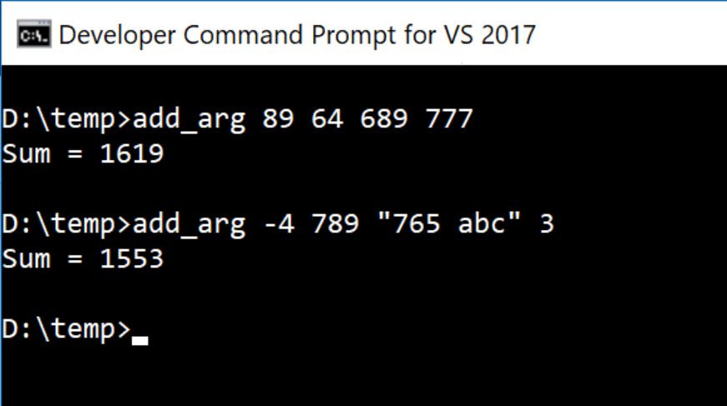
Command-Line Argument: Example
(Optional)
1
2
3
4
5
6
7
8
9
10
11
12
13
#include <iostream>
#include <string> // For using stoi()
using namespace std;
int main(int argc, char *argv[]) {
int sum = 0, x;
for (int i = 1; i < argc; i++) {
x = stoi(argv[i]);
sum += x;
}
cout << "Sum = " << sum << endl;
return 0;
}
You can use "…" to enclose an argument that contains spaces

